Slide 1
Systems engineering
Batarin Egor
MIPT, 2022

Slide 2
Agenda
Systems engineer description
History and definition of systems engineering
Skills of system engineer

Slide 3
Systems engineer description

Slide 4
Systems engineer description

Slide 5
Systems engineer description

Slide 6
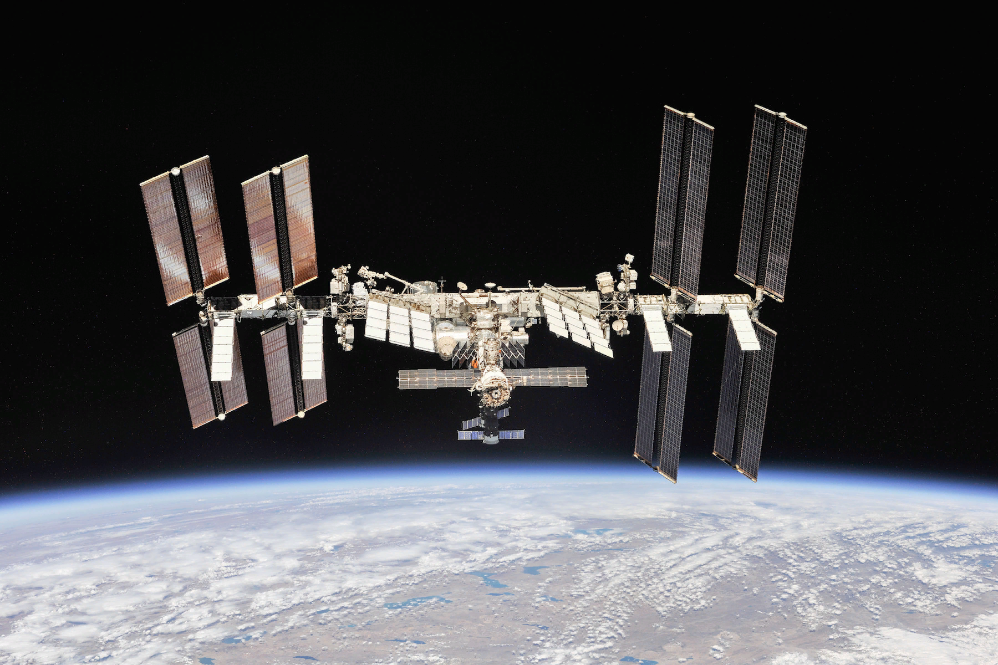
History and definition of systems engineering
https://indirekt.hu/wp-content/uploads/2020/08/ISS.jpg

Slide 7
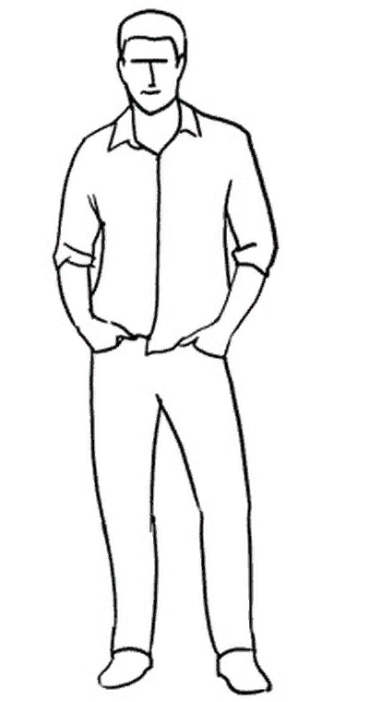
Skills of systems engineer

Slide 8
Skills of systems engineer
The broadest interdisciplinary knowledge

Slide 9

Skills of systems engineer
The broadest interdisciplinary knowledge
Developed leadership and communication skills

Slide 10
Skills of systems engineer
Do not oversleep
the morning
English lesson
The broadest interdisciplinary knowledge
Developed leadership and communication skills
Ability to solve complex problems

Slide 11
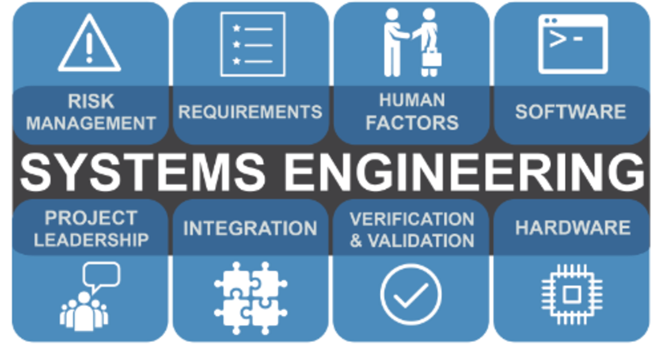
Summary
https://statementsofpurpose.com/files/packed/1wefanscc25vyhb8pjhafy2ydp8hzqvz61m4l75ml5le24p4tivac8ws20gl33spp5ajcy88o3kzd5p4wqcurvfyomn9y4i8qqjtsil4tauq6lefeqw8bxy8meygv68py859uzipwdfaakezb18sdb3wlmqdkozh.png

